Slide 1
Statistics
“The statistician cannot evade the responsibility for understanding the process he applies or recommends.” Fisher 1953
Notes:
a branch of mathematics dealing with the collection, analysis, interpretation, and presentation of masses of numerical data

Slide 2
Variables
Central Tendency
Measures of Dispersion
Probability Distribution
Normal Distribution
Central Limit Theorem
Standard Normal Distribution
OVERVIEW

Slide 3
Statistical Language
Data = records of measurement or observations or simply counts
e.g. the countries where people were born
e.g. number of phonecalls received by the emergency services each day
Variable = characteristics, or quantity (that can be measured or counted or recorded)
e.g. countries
e.g. p
data = values of a variable
Notes:
Data are collected as a source of information

Slide 4
Data Table Example
 | Income per person | Life Expectancy | Savings | Holidays
UK | 40,000 | 80 | 20,000 | 22
France | … | … | … | …
Germany | 38,000 | 85 | 22,000 | 24
 | Variables
Observation 1 | x1 | x2 | x3 | x4
 | … | … | … | …
Observation “n” | xn1 | xn2 | xn3 | xn4
Notes:
Data set or data table - measured or collected data values represented as numbers or text.
Rows – Individual items in a data set.
Columns – list attributes of each item in a row. An attribute is thought of as a set of values describing some aspect across all observations.
Observations – each row is referred to as an observation.
Variables - individual columns in each observation.

Slide 5
Forms of Variables
Quantitative: measured on a suitable scale
= Numerical
Qualitative: defined by a characteristic
= Categorical
(differences between values have numerical meaning)
Continuous
any value
within a given range
i.e. measured
Discrete
only certain values
within a given range
i.e. counted
Nominal
categories that cannot be ranked (no order)
Ordinal
categories that follow a logical hierarchy (ordered)
e.g. age, weight, height, temperature
e.g. heads in 100 coin flips,
number of children in a family
e.g. person’s gender,
eye colour
e.g. academic grades (i.e. A, B, C)
Notes:
Numerical data: interval scale or a ratio scale
interval scale: the differences between two consecutive numbers carry equal significance in any part of the scale
e.g. the difference between 100 and 102 cm is the same as the difference between 176 and 178 cm
interval scale: properties of identity, magnitude, and equal intervals
ratio scale: additional property of a true 0.
Why we care?
statistical methods can only be used with certain data types
e.g. Nominal - frequency / proportion
Ordinal – percentiles
Continuous – histograms, box plot

Slide 6
Types of Variables
independent variable | dependent variable
NOT changed by the other variables | depends on other factors
“X axis” (horizontal) | “Y axis” (vertical)
X causes a change in Y Y cannot change X
synonyms
explanatory variable | explained variable
predictor variable | response variable
regressor | regressand
treatment | outcome
controlled variable | predicted variable
manipulated variable | measured variable
feature | label
Notes:
Dependent Variable: e.g. exam score
Independent Variable: e.g. hours of study, sleep, how much TV, what eaten
NB:
covariate = continuous predictor variable
criterion = dependent variable in non experimental research
EXTRA:
extraneous variables = may alter dependent or independent variables, and in experimentation should be controlled/monitored

Slide 7

Explanatory and Response Variables
To identify the explanatory variable in a pair of variables, identify which of the two is suspected of affecting the other:
Labeling variables as explanatory and response does not guarantee the relationship between the two is actually causal, even if there is an association identified between the two variables. We use these labels only to keep track of which variable we suspect affects the other.

Slide 8
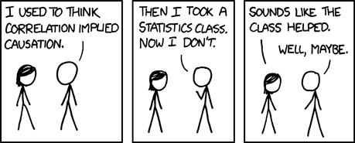
Explanatory and Response Variables
Observational study: Researchers collect data in a way that does not directly interfere with how the data arise, i.e. they merely "observe", and can only establish an association between the explanatory and response variables.
Experiment: Researchers randomly assign subjects to various treatments in order to establish causal connections between the explanatory and response variables.
If you're going to walk away with one thing from this class, let it be "correlation does not imply causation".
http://xkcd.com/552/

Slide 9
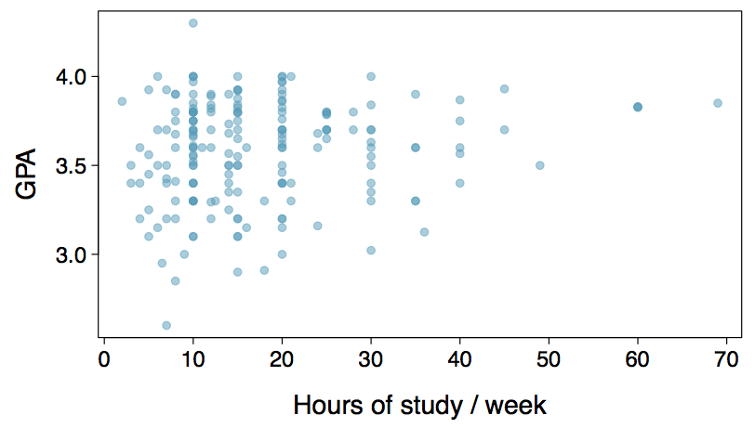
Relationships among variables
Does there appear to be a relationship between the hours of study per week and the GPA of a student?
Can you spot anything unusual about any of the data points?
There is one student with GPA > 4.0, this is likely a data error.
Notes:
Scatterplots are useful for visualizing the relationship between two numerical variables.

Slide 10
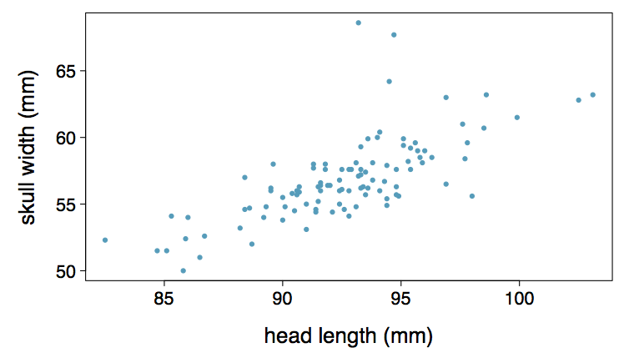
Practice
Based on the scatterplot on the right, which of the following statements is correct about the head and skull lengths of possums?
(a) There is no relationship between head length and skull width,
i.e. the variables are independent.
(b) Head length and skull width are positively associated.
(c) Skull width and head length are negatively associated.
(d) A longer head causes the skull to be wider.
(e) A wider skull causes the head to be longer.
Notes:
Answer highlighted on next slide

Slide 11
Practice
Based on the scatterplot on the right, which of the following statements is correct about the head and skull lengths of possums?
(a) There is no relationship between head length and skull width,
i.e. the variables are independent.
(b) Head length and skull width are positively associated.
(c) Skull width and head length are negatively associated.
(d) A longer head causes the skull to be wider.
(e) A wider skull causes the head to be longer.

Slide 12
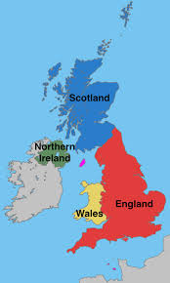
Statistics
Descriptive Statistics
Inferential Statistics
Methods for summarising raw observations
Using small amounts of data to generalise
e.g. the height of women in this room
e.g. using the height of women in this room,
to “infer” the average height of women in UK
Notes:
Descriptive Statistics - describing, presenting, summarizing and organizing your data – via numerical calculations or graphs or tables
i.e. blurb at the back of a book (describes/summarises the book, which can be thought of as the raw data)
Inferential Statistics - drawing conclusions regarding populations – via sample data

Slide 13
Exploratory analysis vs Inference
Sampling is natural.
Think about sampling something you are cooking - you taste (examine) a small part of what you're cooking to get an idea about the dish as a whole.
When you taste a spoonful of soup and decide the spoonful you tasted isn't salty enough, that's exploratory analysis.
If you generalize and conclude that your entire soup needs salt, that's an inference.
For your inference to be valid, the spoonful you tasted (the sample) needs to be representative of the entire pot (the population).
If your spoonful comes only from the surface and the salt is collected at the bottom of the pot, what you tasted is probably not representative of the whole pot.
If you first stir the soup thoroughly before you taste, your spoonful will more likely be representative of the whole pot.

Slide 14
What is the average?
2, 5, 4, 5, 3
write down your answer.

Slide 15
Measures of Central Tendency
aka: measures of center
aka: central locations
aka: averages
A way to summarise a variable
A typical value of a variable
Describes a whole set of data with a single value
Represents the “middle” or central location of a variable
Around which many of the observations’ values lie

Slide 16
e.g.
2, 5, 4, 5, 3
Measures of Central Tendency (Median)
(middle of the set of numbers)
Arrange the numbers in order
find the middle number
“Median” has the
same number of letters
as “Middle” & “Medium”
2, 3, 4, 5, 5
Notes:
NB: Median is not affected by extreme values.
Median: half of obs above and half of obs below

Slide 17
e.g.
2, 5, 4, 5, 3
Measures of Central Tendency (Mode)
(most common number)
Count how many times each value occurs
the highest is the mode
The word MOde
is
similar to MOst
How many?
2: 1
3: 1
4: 1
5: 2
Notes:
NB: Mode is not affected by extreme values.

Slide 18
e.g.
2, 5, 4, 5, 3
Measures of Central Tendency (Mean)
(“fair share” – totalling all data
& sharing equally)
Add the numbers together
divide by the number of numbers
The “Mean” makes you
do arithmetic,
so that’s the “mean” one
(2+5+4+5+3)/5 = 3.8
Notes:
NB: Mean is affected by extreme values; prone to distortion by “outliers”
“outliers” = observations far from center
AKA: Arithmetic Mean

Slide 19
What is the average?
2, 5, 4, 5, 3, 10
2, 5, 4, 5, 3, 101
Median :
Median :
Mode :
Mode :
Mean :
Mean :
When the general public use the word “Average”,
to which of the above three averages are they generally thinking about?
Notes:
Median: 4.5
2, 3, 4, 5, 5, 10
Mode: 5
2, 3, 4, 5, 5, 10
Mean: 4.8
(2+5+4+5+3+10) / 6
Median: 4.5
2, 3, 4, 5, 5, 101
Mode: 5
2, 3, 4, 5, 5, 101
Mean: 20
(2+5+4+5+3+101) / 6
Mean is affected by outliers! (statistically correct, but misleading)

Slide 20
Which average to use?
Nine people earn 100,000 a year, and a tenth person earns 1 billion
5 people in a room aged: 23, 25, 37, 44, 87
Room of 50 students, 30 are 30 years old and the rest are 29 or 31 years old
Five workers who earn $100, $1,000, $10,000, $100,000 and $1,000,000
Four workers earn £10,000, £10,000, £10,000, £50,000 and Owner earns £1,000,000
Four students test scores: 15, 18, 22, 20
Notes:
Median: 100,000 (represents the situation of the majority of the group, the mean income for the group would be 100 million, distortion)
Median: 37 (equal number of people above and below)
Mode: 30 (mode is only useful in certain circumstances)
Median: $10,000 (mean is $220,000 accounts for the extreme cases, whilst the median better indicator of the “middle” salary)
Mode: £10,000 (mean would be unrepresentative, £216,000)
Mean: (15 + 18 + 22 + 20) / 4 = 75 / 4 = 18.75
Generally,
Nominal => Mode
Ordinal => Median
Interval/Ratio (not skewed) => Mean
Interval/Ratio (skewed) => Median

Slide 21
Central Tendency
Is there a best measure of central tendency?
Do all datasets have a median, mode and mean?
When to choose the mean?
When to choose the mode?
When to choose the median?
If data has outliers, which measure of central tendency is most appropriate?
In a normally distributed data set, which is greatest: mode, median or mean?
For any data set, which measures of central tendency have only one value?
Notes:
Is there a best measure of central tendency?
No, but there is often a "best" measure of central tendency with regards to the data you are analysing
Do all datasets have a median, mode and mean?
All continuous data has a median, mode and mean
ordinal data has a median and mode only (the mean’s existence is still under debate)
nominal data has only a mode
When to choose the mean?
When distribution of data is continuous and symmetrical (but depends on what your goals are)
Not with categorical data (can’t sum the values)
When to choose the mode?
When data is nominal (or ordinal)
When to choose the median?
When data set is not symmetrically distribution or you are dealing with ordinal data
If data has outliers, which measure of central tendency is most appropriate?
median (mean can be distorted by the outliers) (depends on how influential the outliers are)
In a normally distributed data set, which is greatest: mode, median or mean?
mean, median and mean are equal to each other (i.e., the same value).
For any data set, which measures of central tendency have only one value?
The median and mean can only have one value for a given data set. The mode can have more than one value

Slide 22
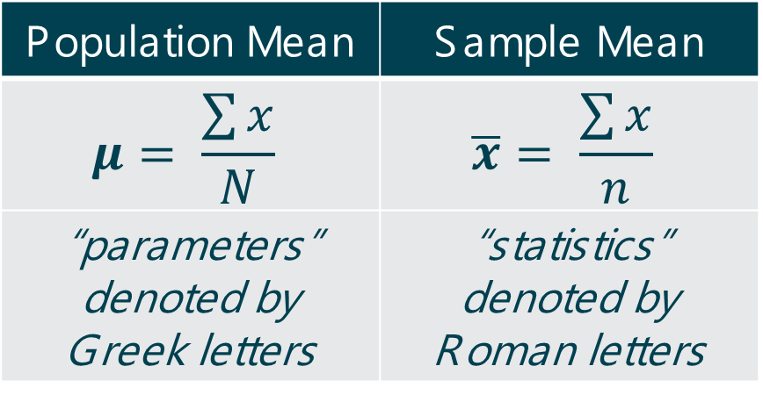
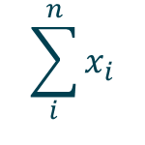
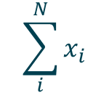
Summaries of Data
a population data = a group with at least one characteristic in common
a sample data = a subset of a larger population
$$\sum_{i}^{N}{x_{i}}$$
Population Mean | Sample Mean
$$μ= \frac{\sum{x}}{N}$$ | $$\overline{x}= \frac{\sum{x}}{n}$$
“parameters” denoted by Greek letters | “statistics” denoted by Roman letters
$$\sum_{i}^{n}{x_{i}}$$
Σ = Greek “sigma” = “sum of...”
N = number of data points in a population
n = number of data points in a sample
Notes:
e.g. discussing/studying Data about English Farms;
then the first question will need to determine the population:
- all farms in England?
- Or farms that grow crops?
- Or those that have livestock? etc

Slide 23

What does Central Tendency NOT tell us?
No insight into the variation or distribution around this central location
How to gain this insight ?
Frequency Distribution
What is a Frequency Distribution ?
A count of how many times each value occurs.
How many?
2: 1
3: 1
4: 1
5: 2
Notes:
Often data are presented as a frequency table
frequencies for class intervals or individual data values

Slide 24
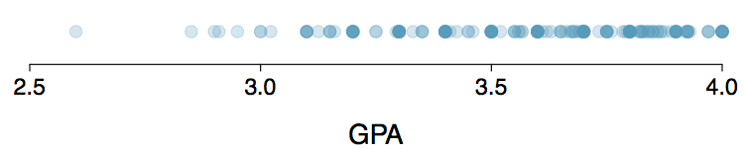
Dot Plots
Useful for visualizing one numerical variable.
Darker colors represent areas where there are more observations.
How would you describe the distribution of GPAs in this data set?
Notes:
Answer can include something about the center, shape, and spread of the distribution

Slide 25
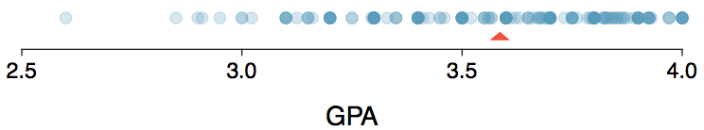
Dot Plots & Mean
mean (marked with a triangle in the above plot), is one way to measure the center of a distribution of data.
(mean GPA is 3.59)

Slide 26
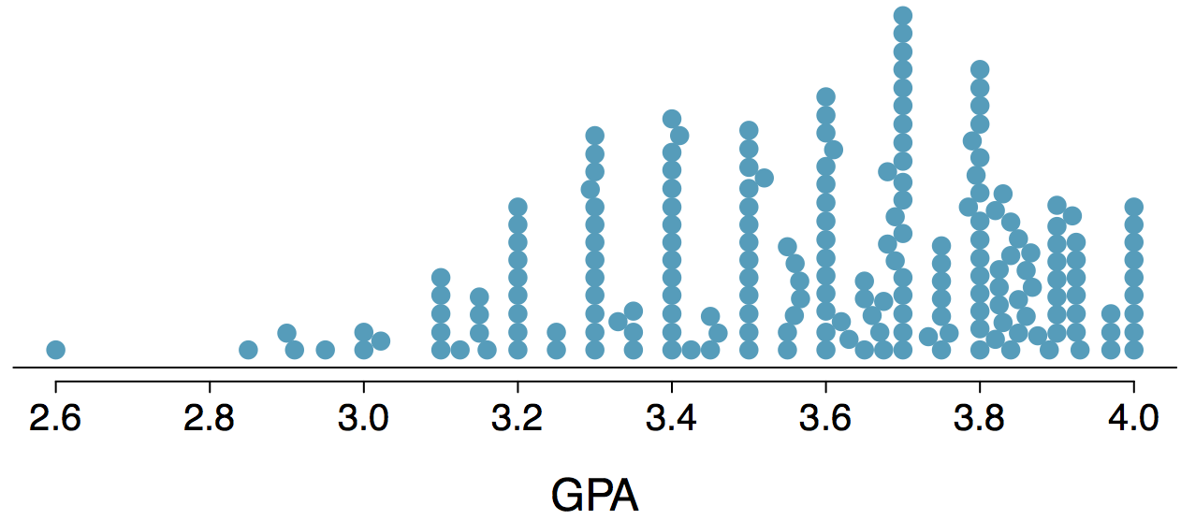
Stacked Dot Plot
Higher bars represent areas where there are more observations, makes it a little easier to judge the center and the shape of the distribution.

Slide 27
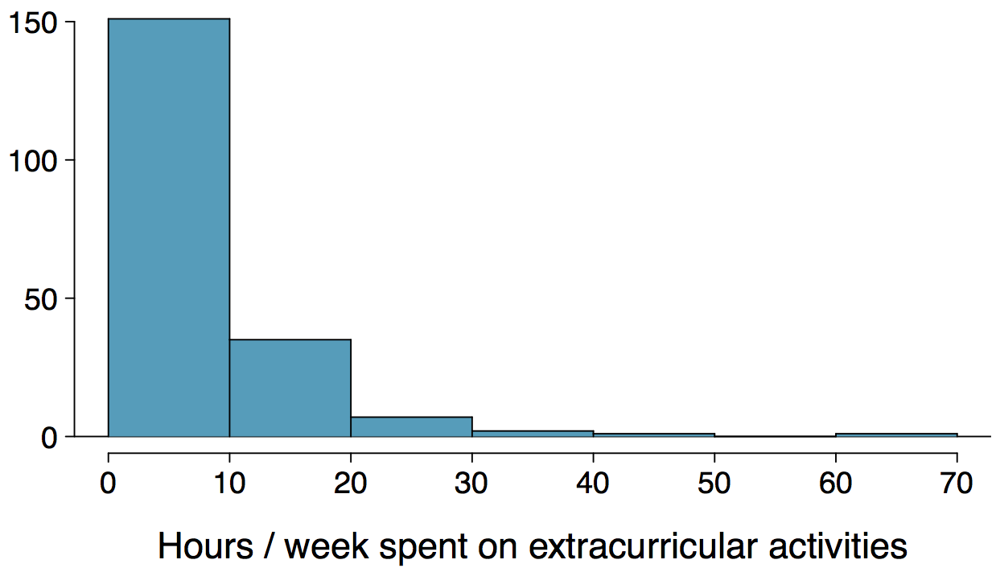
Histograms
Histograms provide a view of the data density
Higher bars represent where the data are relatively more common.
describing the shape of the data distribution.
The chosen bin width can alter the story the histogram is telling.

Slide 28
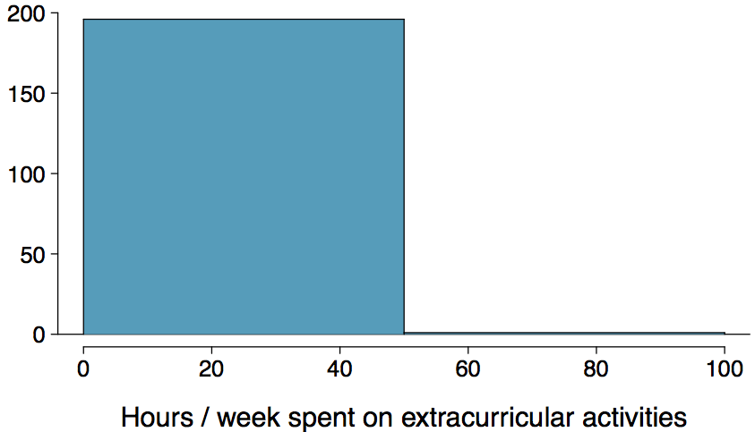
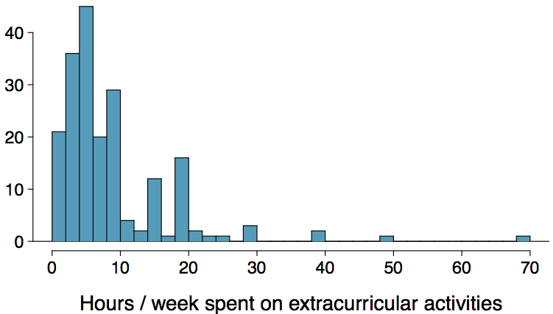
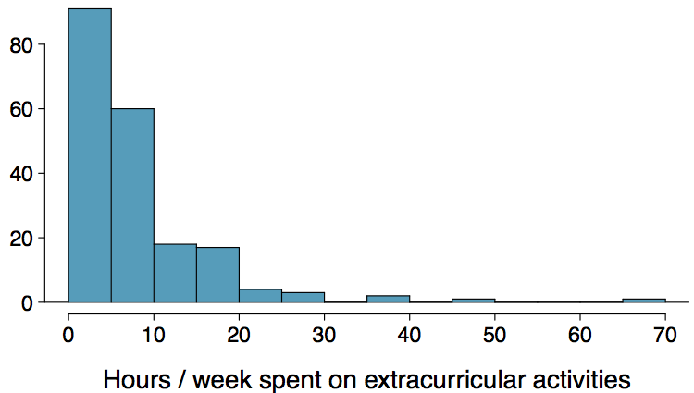
Bin Width
Which one(s) of these histograms are useful? Which reveal too much about the data? Which hide too much?

Slide 29
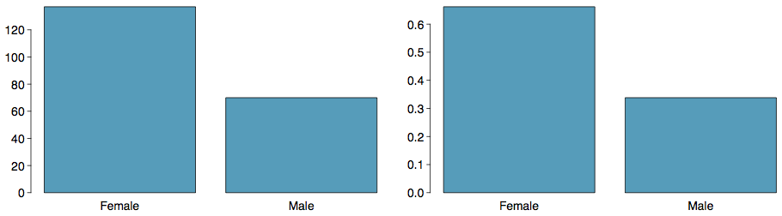
Bar Plots
bar plot = displays the distribution of a single categorical variable
relative frequency bar plot => proportions (instead of frequencies)
histograms are used for numerical variables
x-axis in a histogram is a number line
order of the bars cannot be changed
bar plots
categories can be listed in any order

Slide 30
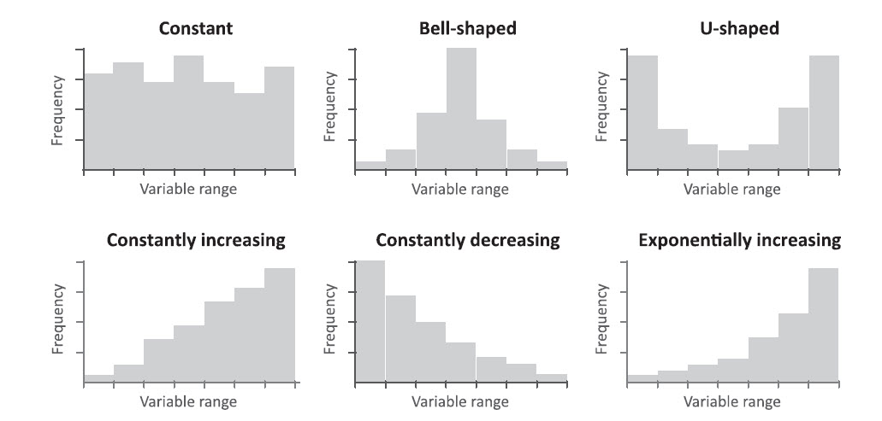
Frequency Distribution: Histogram
Notes:
Visualising the freq distn, benefits include:
range of values
shape created when the values are plotted
outliers

Slide 31
Measures of Dispersion
measure how spread out a set of data is
amount of variation of a particular variable
describe the spread of data around a central value (mean, median or mode)
how much variability there is in the data

Slide 32

Measures of Dispersion (Range)
The range is the difference between the highest and lowest values.
Sensitive to extreme values:
Example: 2, 3, 4, 6, 7, 7, 8, 19
Range = 19 - 2 = 17

Slide 33
Measures of Dispersion (IQR)
k^{th} Percentile = value below which k percentage of observations falls
Step 1: Arrange the values of data into ascending order (from smallest to largest)
Step 2: Multiply k% by n => index
Step 3: Count the values until this index (interpolated for values that do not exist)
We can state the value at any given percentile, for example:
the median represents the 50th percentile (the middle)
25th percentile = “lower quartile”, one quarter of the ordered data is below this value
75th percentile = “upper quartile”, one quarter of the ordered data is above this value
We can calculate the range of values between any two percentiles:
the range of values between the 25th percentile and the 75th percentile
= 75th percentile - 25th percentile
= “interquartile range” = “IQR“
= range of the middle 50% of observations about median
Example: 2, 3, 4, 6, 7, 7, 8, 19; 25th Percentile: 3.5; 50th Percentile: 6.5; 75th Percentile: 7.5; IQR: 4
Notes:
Why useful?
If distribution of data are not symmetric
NB:
The 25th percentile is also called the first quartile, Q1.
The 50th percentile is also called the median.
The 75th percentile is also called the third quartile, Q3.

Slide 34
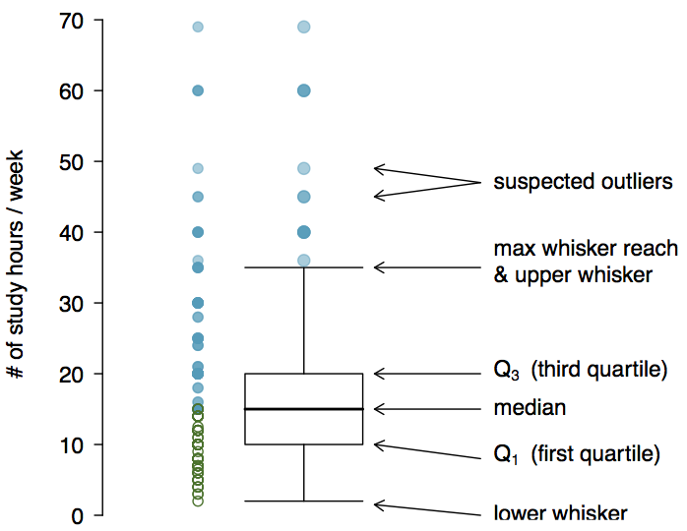
Box Plot
Notes:
The box in a box plot represents the middle 50% of the data, and the thick line in the box is the median.
Whiskers of a box plot can extend up to 1.5 x IQR away from the quartiles:
max upper whisker reach = Q3 + 1.5 x IQR
max lower whisker reach = Q1 - 1.5 x IQR
A potential outlier = an observation beyond the maximum reach of the whiskers. (appears extreme relative to the rest of the data)

Slide 35

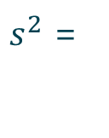

Measures of Dispersion (Variance)
The variance describes the spread of the data.
Measures how much the values of a variable differ from the mean.
$$\overline{x}= \frac{\text{2}\text{+}\text{3}\text{+}\text{4}\text{+}\text{6}\text{+}\text{7}\text{+}\text{7}\text{+}\text{8}\text{+19} }{8}=7$$
$$s^{2}= \frac{{\text{(}\text{2−7)}}^{2}\text{+}{\text{(}\text{3}\text{−7)}}^{2}\text{+}{\text{(}\text{4}\text{−7)}}^{2}\text{+}{\text{(}\text{6}\text{−7)}}^{2}\text{+}{\text{(}\text{7}\text{−7)}}^{2}\text{+}{\text{(}\text{7}\text{−7)}}^{2}\text{+}{\text{(}\text{8}\text{−7)}}^{2}\text{+}{\text{(}\text{19−7)}}^{2}}{8−1}$$
$s^{2}=$ $\frac{25+16+9+1+0+0+1+144}{7}$
$s^{2}=$ 28
$$\sum_{i=1}^{n}{{\left(x_{i}−\overline{x}\right)}^{2}}$$
$$n−1$$
$s^{2}$ =
Notes:
Why do we square the distance from the mean?
e.g. 0 2 4 => (0-”2”) + (2-”2”) + (4-”2”) => -2 + 0 +2 => 0 => var = 0 ☹
e.g. 0 2 4 => (0-2)² + (2-2)² + (4-2)² => +4 + 0 +4 => 8 => var = 4 ☺

Slide 36
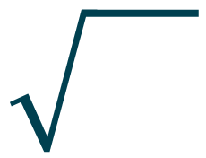


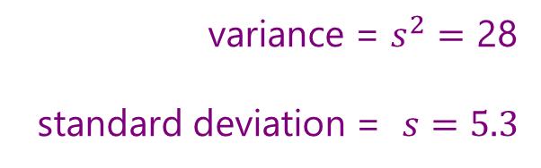
Measures of Dispersion (Standard
Deviation)
standard deviation = square root of the variance
$$\sum_{i=1}^{n}{{\left(x_{i}−\overline{x}\right)}^{2}}$$
$$n−1$$
variance = $s^{2}=$ 28
standard deviation = $s=5.3$
$s$=
Standard deviation reflects how tightly the observations cluster around the mean.
a high proportion of observations usually lie within “one SD” of the mean.
e.g. average height of men = 5 feet 9 inches, with SD of 3 inches.
a high proportion of men are between 5 feet 6 inches and 6 feett
NB: the higher the value (of $s$), the more widely distributed the variable’s data values are around the mean.

Slide 37


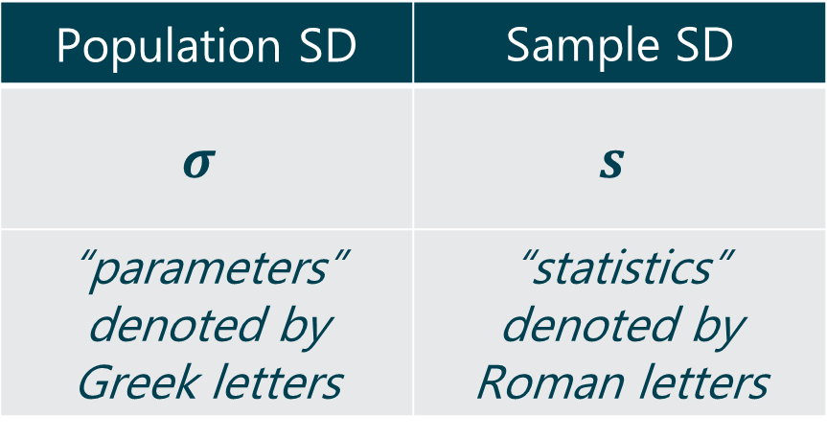
Standard Deviation of Data
a population data = a group with at least one characteristic in common
a sample data = a subset of a larger population
Population SD | Sample SD
$$σ$$ | $$s$$
“parameters” denoted by Greek letters | “statistics” denoted by Roman letters
$$\sum_{i=1}^{N}{{\left(x_{i}−\overline{x}\right)}^{2}}$$
$$N$$
$$\sum_{i=1}^{n}{{\left(x_{i}−\overline{x}\right)}^{2}}$$
$$n−1$$
Σ = Greek “sigma” = “sum of...”
N = number of data points in a population
n = number of data points in a sample

Slide 38
Obtaining Good Samples
If a sample is random then the estimates are reliable.
Most commonly used random sampling techniques:
Simple Random Sampling
Stratified Sampling
Cluster Sampling

Slide 39
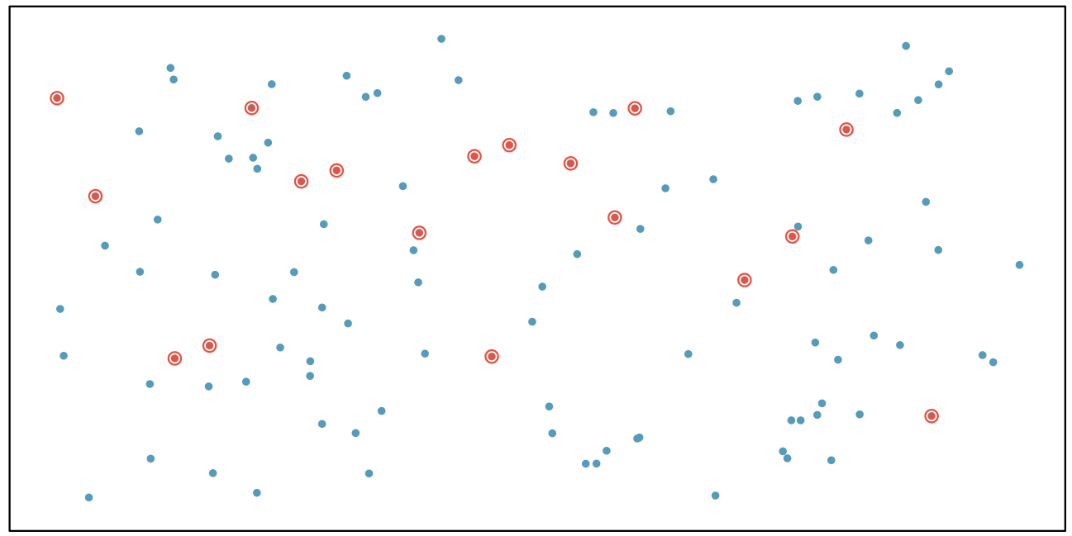
Simple Random Sample
Randomly select cases from the population, where there is no implied connection between the points that are selected.

Slide 40
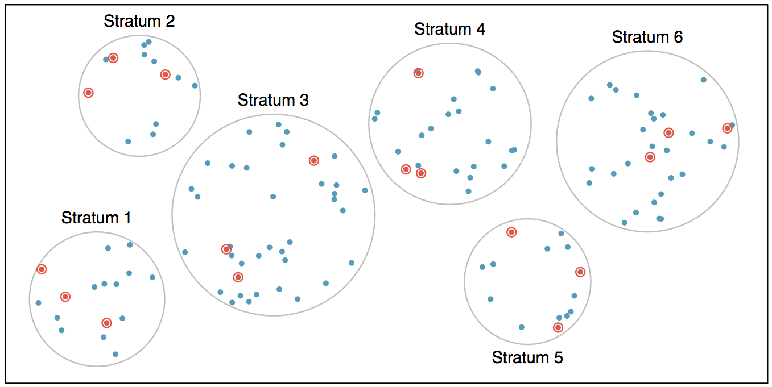
Stratified Sample
Strata are made up of similar observations. We take a simple random sample from each stratum.

Slide 41
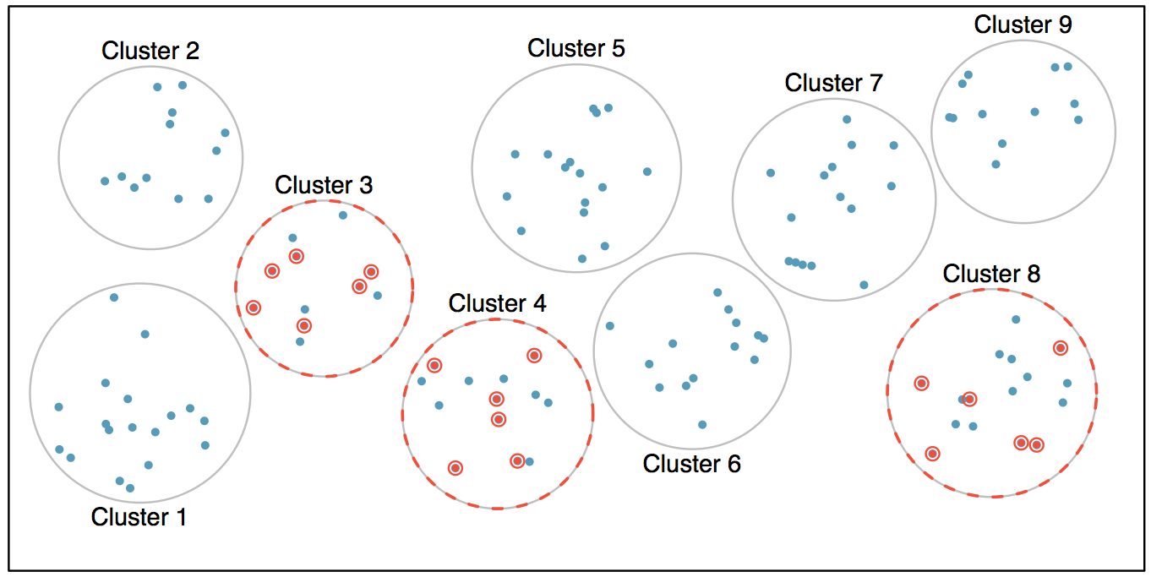
Cluster Sample
Clusters are usually not made up of homogeneous observations, and we take a simple random sample from a random sample of clusters.

Slide 42
Practice
A city council has requested a household survey be conducted in a suburban area of their city. The area is broken into many distinct and unique neighborhoods, some including large homes, some with only apartments. Which approach would likely be the least effective?
(a) Simple random sampling
(b) Cluster sampling
(c) Stratified sampling
(d) Blocked sampling

Slide 43
Practice
A city council has requested a household survey be conducted in a suburban area of their city. The area is broken into many distinct and unique neighborhoods, some including large homes, some with only apartments. Which approach would likely be the least effective?
(a) Simple random sampling
(b) Cluster sampling
(c) Stratified sampling
(d) Blocked sampling

Slide 44
Probability Distribution
Probability distribution = a list of outcomes and their associated probabilities.
Probability mass function = a function that represents a discrete probability distribution
Discrete outcomes = a specific number of values each with a specific probability
What is the probability of an event occurring? The output from the probability mass function.
Combinations of TWO dice
Probability of Combinations
Notes:
Count = Frequencies = Observed
Probability = Calculated = # occurrences / # all possible outcomes
pmf obey the rules of probability:
1) probability of all possible outcomes sums to 1;
2) can combine probabilities, via adding, multiplying

Slide 45
Probability Distribution
Probability distribution = a list of outcomes and their associated probabilities.
Probability density function = a function that represents a continuous probability distribution
Continuous outcomes = an infinite number of possible values each with a specific probability
What is the probability of an event occurring? The area under the probability density function.
Age of Children in a Playground
Notes:
e.g. probability of being between 6.5 and 7.5 = 62% - 38% = 24%
e.g. probability of being under 7 years old = 50%
pdf obey the rules of probability:
1) probability of all possible outcomes sums to 1;
2) can combine probabilities, via adding, multiplying.

Slide 46
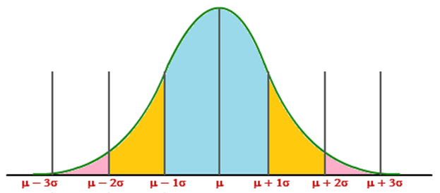
Measures of Dispersion (Standard
Deviation)
For a normal frequency distribution
about 68% of all observations
will fall within one standard deviation of the mean:
34% of the observations are 1 standard deviation below of the mean
34% of the observations are 1 standard deviation above of the mean
Notes:
P(x<μ) = 50%
Σ(P) = 100% = area under pdf

Slide 47
Sample Size↑ ⇒ Standard Deviation ↓
n ↑ ⇒ s ↓
smaller spread of values about the mean
larger number of values
n=150
n=50
large spread
small sample
n=10

Slide 48
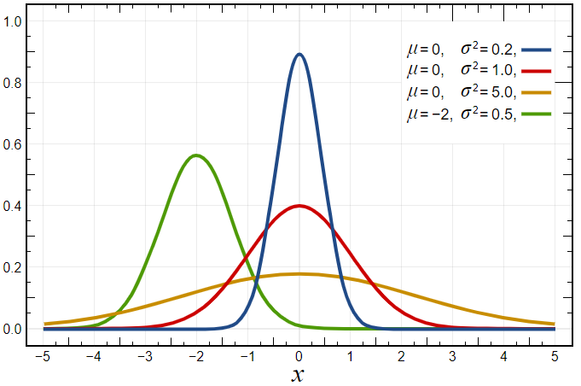
Normal Distribution
Describes many common phenomena
heights of adult humans
scores on a test given to a large class
errors in measurements
Normal distributions are:
continuous probability distributions
bell-shaped symmetrical distribution
a family of distributions of the same general form, with two parameters:
μ (the mean) (“location”)
σ (the SD) (“scale”)
What are the measures of central tendency?
mean = median = mode = μ
Notes:
$$f\left(x\right)= \frac{1}{σ\sqrt{2π}}e^{−\frac{1}{2}{(\frac{x−μ}{σ})}^{2}}$$
Unimodal
Symmetric about the mean
Flattens symmetrically as the variance is increased
Tails may extend toward infinity
Total area = 1
first application: analysis of errors of measurement made in astronomical observations (Galileo)
errors due to imperfect instruments and imperfect observers
errors were symmetric
small errors occurred more frequently than large errors
hypothesized distributions of errors followed a normal distribution
Gaussian distribution, named after the German mathematician, Karl Friedrich Gauss (1777-1855)

Slide 49
Are all samples the same?
In an ideal world we would use all the population data
In reality, this is usually NOT practical, we use sample data
We expect a sample to provide information that is applicable to the entire population, however, different samples may have different properties:
Three samples from a population, each giving different means
50
55
60

Slide 50
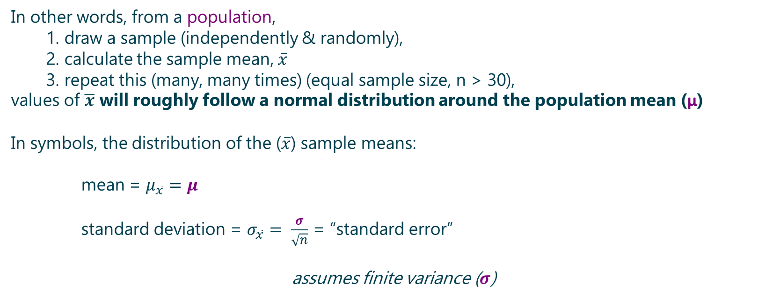
Central Limit Theorem
Given a sufficiently large sample size from a population with a finite level of variance, the mean of all samples from the same population will be approximately equal to the mean of the population
In other words, from a population,
1. draw a sample (independently & randomly),
2. calculate the sample mean, $\overline{x}$
3. repeat this (many, many times) (equal sample size, n > 30),
values of $\overline{x}$ will roughly follow a normal distribution around the population mean (μ)
In symbols, the distribution of the ($\overline{x}$) sample means:
mean = $μ_{\overline{x}}=μ$
standard deviation = $σ_{\overline{x}}= \frac{σ}{\sqrt{n}}$ = “standard error”
assumes finite variance ($σ$)
Notes:
some $\overline{x}$ will a little higher than μ
some $\overline{x}$ will a little lower than μ
a very few $\overline{x}$ will be significantly higher than μ
a very few $\overline{x}$ will be significantly lower than μ
This theorem is the reason why we use of the normal distribution

Slide 51
Central Limit Theorem
Valid for any distribution of a population – see jupyter notebook to understand the Sampling Distribution of the Sample Mean

Slide 52
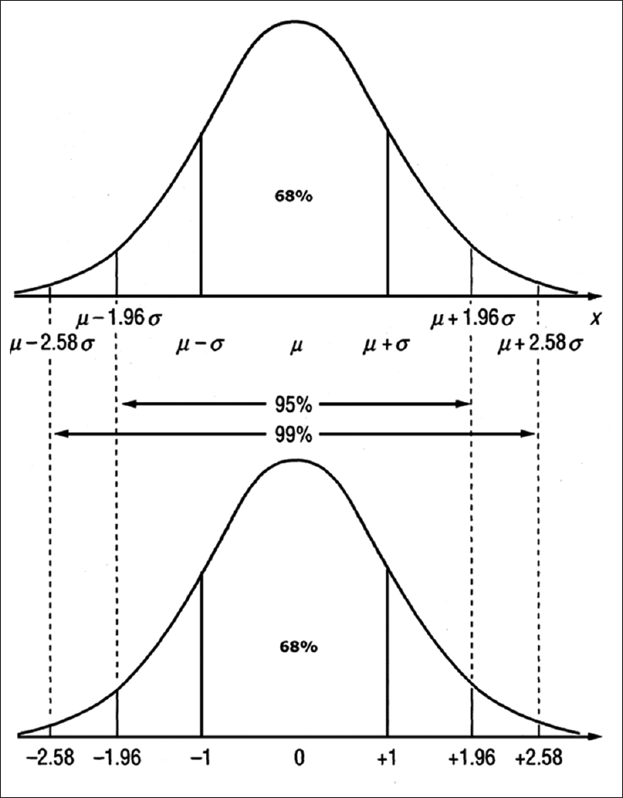
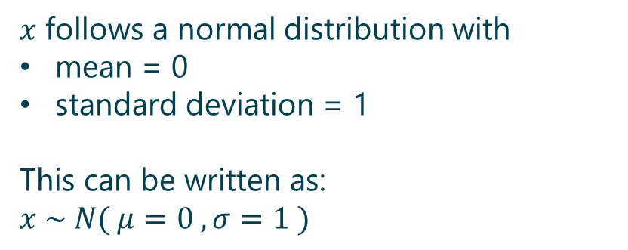
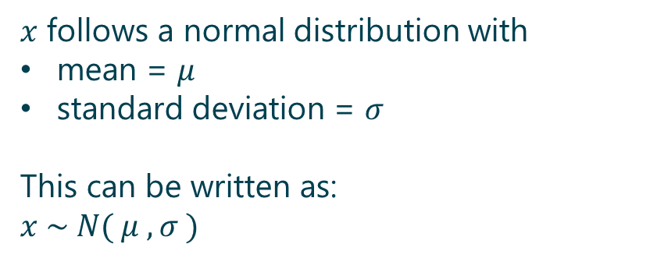
Normal Distribution
$x$ follows a normal distribution with
mean = $μ$
standard deviation = $σ$
This can be written as:
$$x \sim N( μ , σ )$$
$x$ follows a normal distribution with
mean = 0
standard deviation = 1
This can be written as:
$$x \sim N( μ=0 , σ=1 )$$

Slide 53
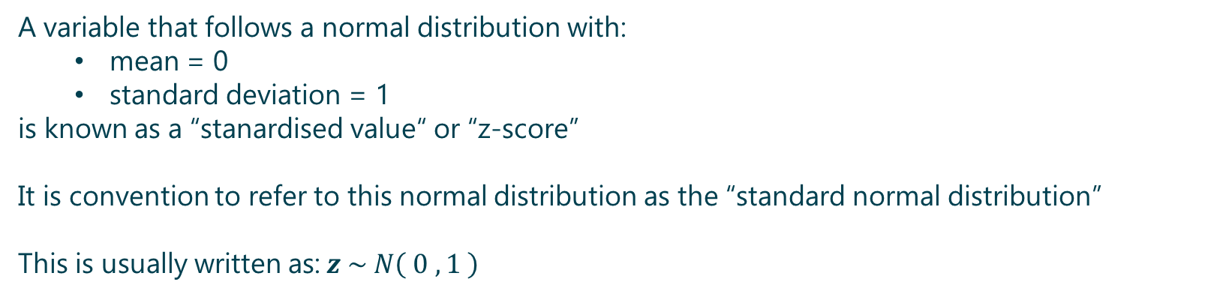
Standard Normal Distribution
A variable that follows a normal distribution with:
mean = 0
standard deviation = 1
is known as a “stanardised value“ or “z-score”
It is convention to refer to this normal distribution as the “standard normal distribution”
This is usually written as:$z \sim N\left( 0 , 1 \right)$
Notes:
Note$z \sim N\left( 0 , 1 \right)$ as opposed to $x \sim N( μ=0 , σ=1 )$

Slide 54
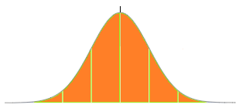
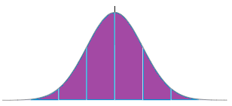



Standardise
Normal Distribution
Standard Normal Distribution
$$x \sim N( μ , σ)$$
$$Z \sim N(μ=0, σ=1)$$
z-score = $z=\frac{x − μ}{σ}$
“standardise”
Benefits?
Transforming data to comparable scales can prevent variables with larger ranges outweighing those with smaller ranges
Standardised scores are without units, because units are cancelled when we standardise the spread.
Notes:
The z score can be interpreted in units of the standard deviation
e.g. $x \sim N\left( μ=4 , σ=2\right)$
An “x = 10” is three standard deviations above the mean
x = μ + (z)(σ)
= 4 + (3)(2)
= 10

Slide 55
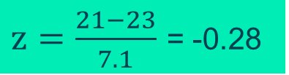



Standardise: Example
Exam results (maximum score: 60): 21, 14, 25, 31, 30, 17, 36, 13, 27, 21, 18
Normal Distribution
Standard Normal Distribution
$$x \sim N( μ , σ)$$
$$Z \sim N(μ=0, σ=1)$$
z-score = $z=\frac{x − μ}{σ}$
“standardise”
8
16
23
30
37
-2
-1
0
1
2
$z=\frac{21−23}{7.1}$ = -0.28

Slide 56
Standardise: Example
Exam results (maximum score: 60): 21, 14, 25, 31, 30, 17, 36, 13, 27, 21, 18
The area under the original distribution to the left of 16 represents the same probability as the area under the standard normal distribution to the left of -1 i.e. P(x<16) = P(z<-1)
8
16
23
30
37
-2
-1
0
1
2
Standardised Z scores have known probability values
P(x<23) = 0.5 = 50%
P(z<0) = 0.5 = 50%
P(9.1<x<36.9) = 95%
P(-1.96< z <1.96) = 95%

Slide 57
Standardise: Example: Benefits
Exam results (out of 60 points):
21,14,25,31,30,17,36,13,27,21,18
A pass mark of 50%, would lead to most failing
The exam was tough, so we could standardise the scores, and
fail those students “one standard deviation” below the mean
Sum = 253, Mean = 23, Standard Deviation = 7.1
Standardised Scores:
-0.28, -1.27, 0.28, 1.13, 0.99, -0.85, 1.83, -1.41, 0.56, -0.28, -0.70
After standardising, only TWO students will fail

Slide 58
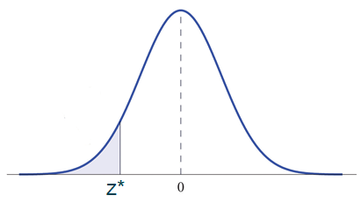
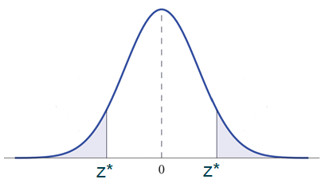
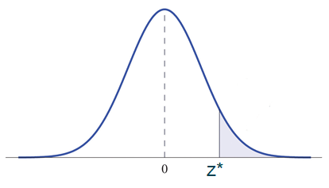




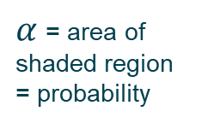


Standard Normal Distribution: Tails
$α$ = area of shaded region = probability
$$\frac{α}{2}$$
$$\frac{α}{2}$$
$α$ = area of shaded region = probability
-
P( Z < z* ) = $α$
P( Z > z* ) = $α$
P( Z < -z* & Z > z* ) = $α$
P( Z < -1.64 ) = 5%
P( Z < -1.96 & Z > +1.96 ) = 5% total
P( Z > +1.64 ) = 5%
P ( Z < -2.33 ) = 1%
P( Z < -2.57 & Z > +2.57 ) = 1% total
P ( Z > +2.33 ) = 1%
Notes:
“z*” = “Z Critical Value”
What is the probability of an exam result less than 11.5 ?
Convert this from X to Z, via: (11.5 – 23) / 7.1 = -1.62 => probability is approximately 5%
What is the probability of an exam result less than 23?
50%
What is the probability of an exam result between 9 and 36?
5%
(9 – 23) / 7.1 = -1.96
(36 – 23) / 7.1 = -1.96

